Slide 1

Lung Cancer Risk in 25 Countries
Project porfolio
Duyen Huynh

Slide 2

Introduction of dataset
This dataset contains information on lung cancer risk factors across various countries, focusing on demographic details, smoking behaviors, and family history.
Data source: Kaggle (License: MIT)
https://www.kaggle.com/datasets/aizahzeeshan/lung-cancer-risk-in-25-countries/data
2

Slide 3





Purpose of analysis
SMOKING BEHAVIOR
DEmographicS
Regional Variations
Public heath
Smoking habits, exposure to secondhand smoke, and family history
Age/ Gender
Different countries and regions
Populations with high-risk behaviors
Lung cancer
3

Slide 4
Column Name | Description
ID | Unique identifier for each record
Country | Name of the country
Population_Size | Total population size of the country (in millions)
Age | Age of the individual (in years)
Gender | Gender of the individual (Male / Female)
Smoker | Whether the individual is a smoker (Yes / No)
Years_of_Smoking | Number of years the individual has been smoking
Cigarettes_per_Day | Average number of cigarettes smoked per day
Passive_Smoker | Whether the individual is regularly exposed to secondhand smoke
Family_History | Whether there is a family history of lung cancer (Yes / No)
Chronic_Lung_Disease | Presence of pre-existing chronic lung conditions (Yes / No)
Radiation_Exposure | Exposure to radiation (Yes / No)
Air_Pollution_Exposure | Level of exposure to air pollution (Low / Medium / High)
Occupational_Exposure | Whether the person is exposed to carcinogens at work (Yes / No)
Indoor_Pollution | Whether the individual is exposed to indoor pollutants (Yes / No)
Healthcare_Access | Quality of healthcare access (Good / Moderate / Poor)
Early_Detection | Whether lung cancer was detected early (Yes / No)
Treatment_Type | Type of treatment received (None, Surgery, Radiation, etc.)
Developed_or_Developing | Economic status of the country (Developed / Developing)
Annual_Lung_Cancer_Deaths | Number of deaths from lung cancer per year in the country
Lung_Cancer_Prevalence_Rate | Percentage of population diagnosed with lung cancer
Mortality_Rate | Mortality rate due to lung cancer (possibly normalized or % value)
DATA DICTIONARY
4

Slide 5
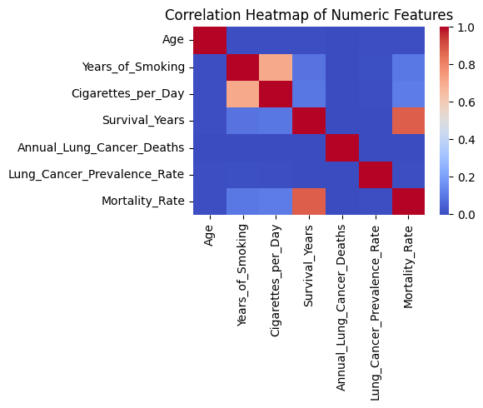
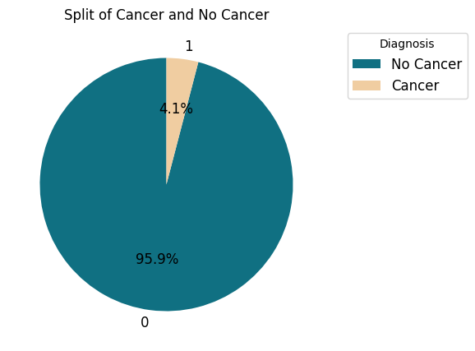
Exploring DATA of RISK FACTORs Diagnosis & Correlations
Heatmap of numeric columns
Lung cancer diagnosis
5

Slide 6
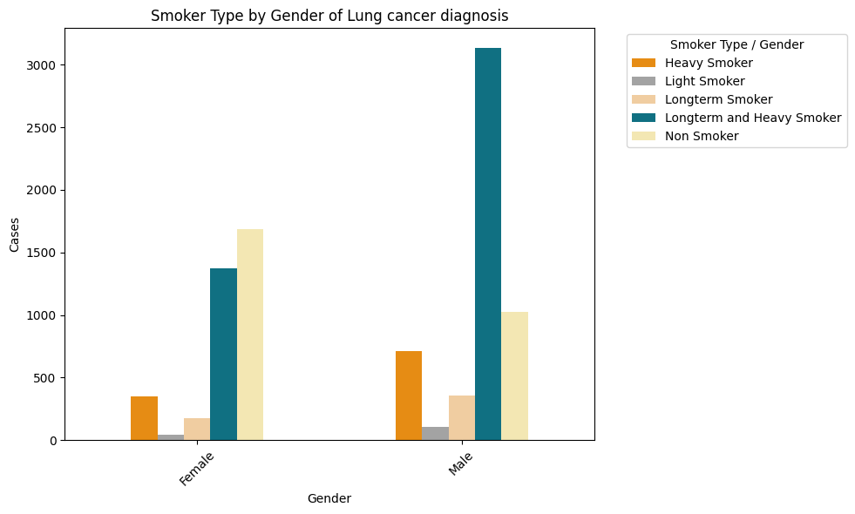
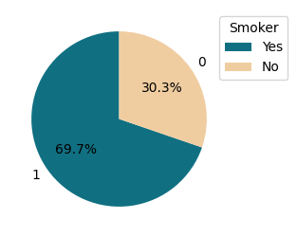
Exploring DATA of RISK FACTORs Smoker TYPEs
Only lung cancer diagnosis (Cancer) by Smoker
Smoker types by Gender of lung cancer diagnosis (Cancer)
Smoker types | Feature engineering
Heavy smoker | Above Average Cigarettes per Day
Longterm smoker | Above Average Years of Smoking
Light smoker | Below Average Cigarettes per Day and Years of Smoking
6

Slide 7
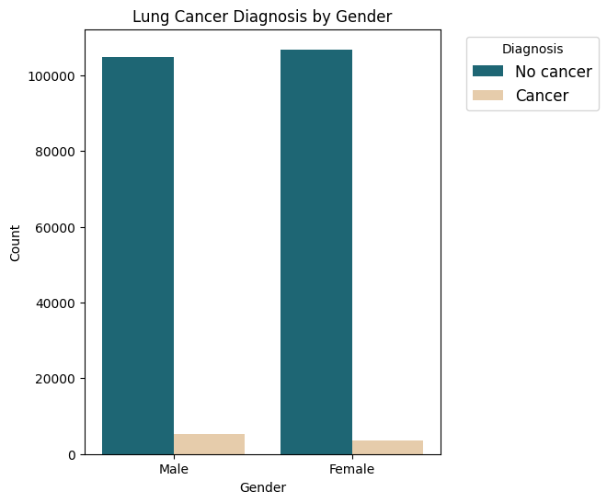
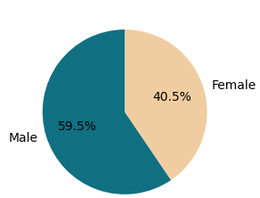
Exploring DATA of DEMOGRAPHICS
Diagnosis & GENDER
Lung cancer diagnosis by Gender
Only lung cancer diagnosis (Cancer) by Gender
Lung_Cancer_Diagnosis | No cancer | Cancer | Total
Gender
Female | 106859 | 3629 | 110488
Male | 104812 | 5332 | 110144
Total | 211671 | 8961 | 220632
7

Slide 8
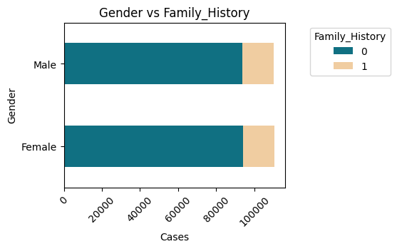
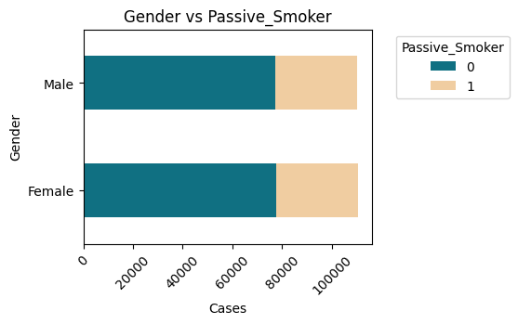
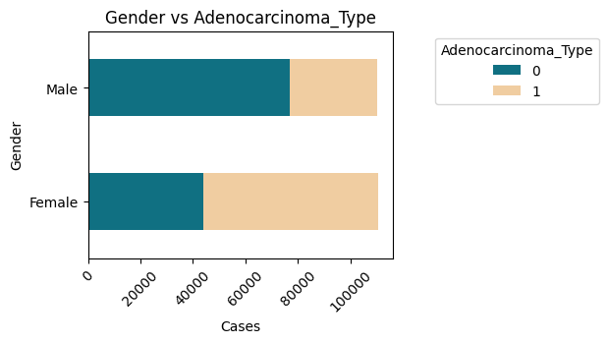
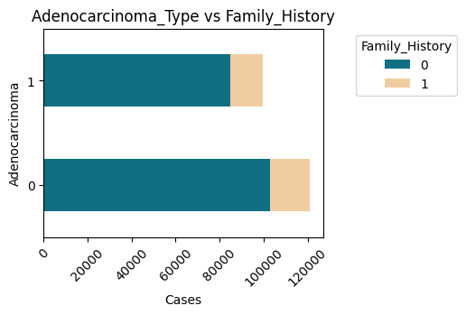
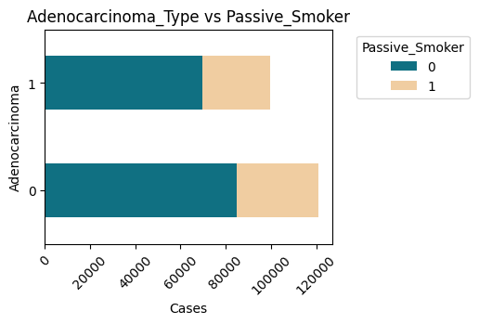
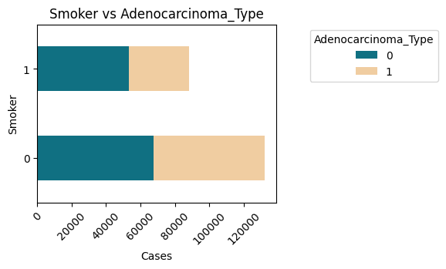
Exploring DATA of DEMOGRAPHICS
Family HIStory, passive smoker, adenocarcinoma & gender/ smoker
8

Slide 9
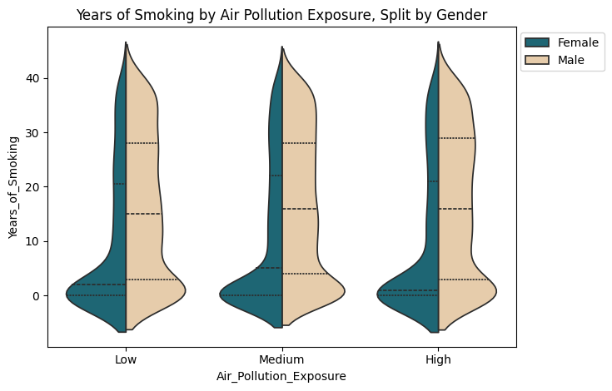
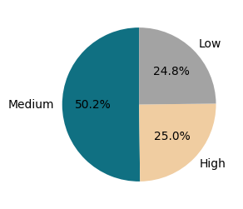
Exploring DATA of RISK FACTORs
SMOKING HISTORY, AIR POLLUTION EXPOSURE by GENDER
Air pollution exposures
9

Slide 10
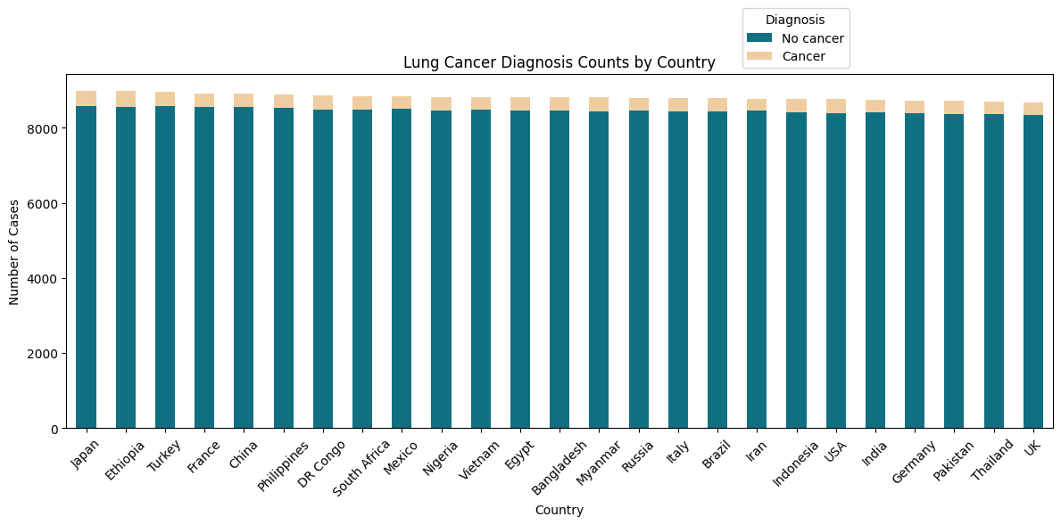
Regional Variations CANCER Diagnosis
Lung_Cancer_Diagnosis | Population_Size | No cancer | Cancer
Japan | 125 | 8591 | 398
Ethiopia | 120 | 8566 | 409
Turkey | 85 | 8578 | 388
France | 65 | 8555 | 365
China | 1400 | 8569 | 338
Philippines | 113 | 8533 | 351
DR Congo | 95 | 8497 | 364
South Africa | 59 | 8497 | 357
Mexico | 128 | 8501 | 336
Nigeria | 206 | 8452 | 377
Vietnam | 97 | 8493 | 336
Egypt | 102 | 8451 | 371
Bangladesh | 166 | 8460 | 361
Myanmar | 54 | 8446 | 373
Russia | 145 | 8464 | 340
Italy | 60 | 8430 | 372
Brazil | 213 | 8447 | 353
Iran | 84 | 8452 | 326
Indonesia | 273 | 8405 | 366
USA | 331 | 8392 | 377
India | 1380 | 8417 | 335
Germany | 83 | 8395 | 332
Pakistan | 225 | 8377 | 346
Thailand | 70 | 8370 | 339
UK | 67 | 8333 | 351
10

Slide 11
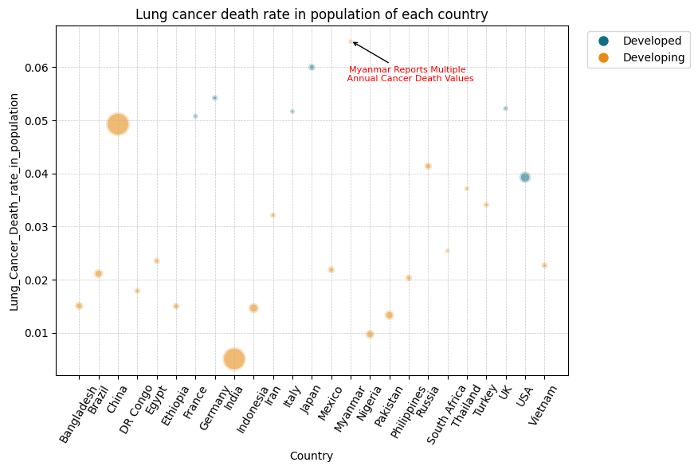
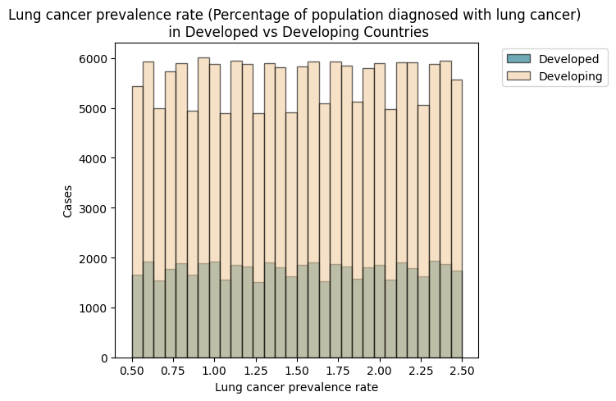
Regional Variations LUNG CANCER DEATHS RATE & population size / DeVELOPMENT LEVEL
* Notes:
Lung cancer prevalence rate: Provided by dataset
Lung cancer death rate: Annual lung cancer deaths / population size
Myanmar: There are many annual lung cancer death values within a year
11

Slide 12
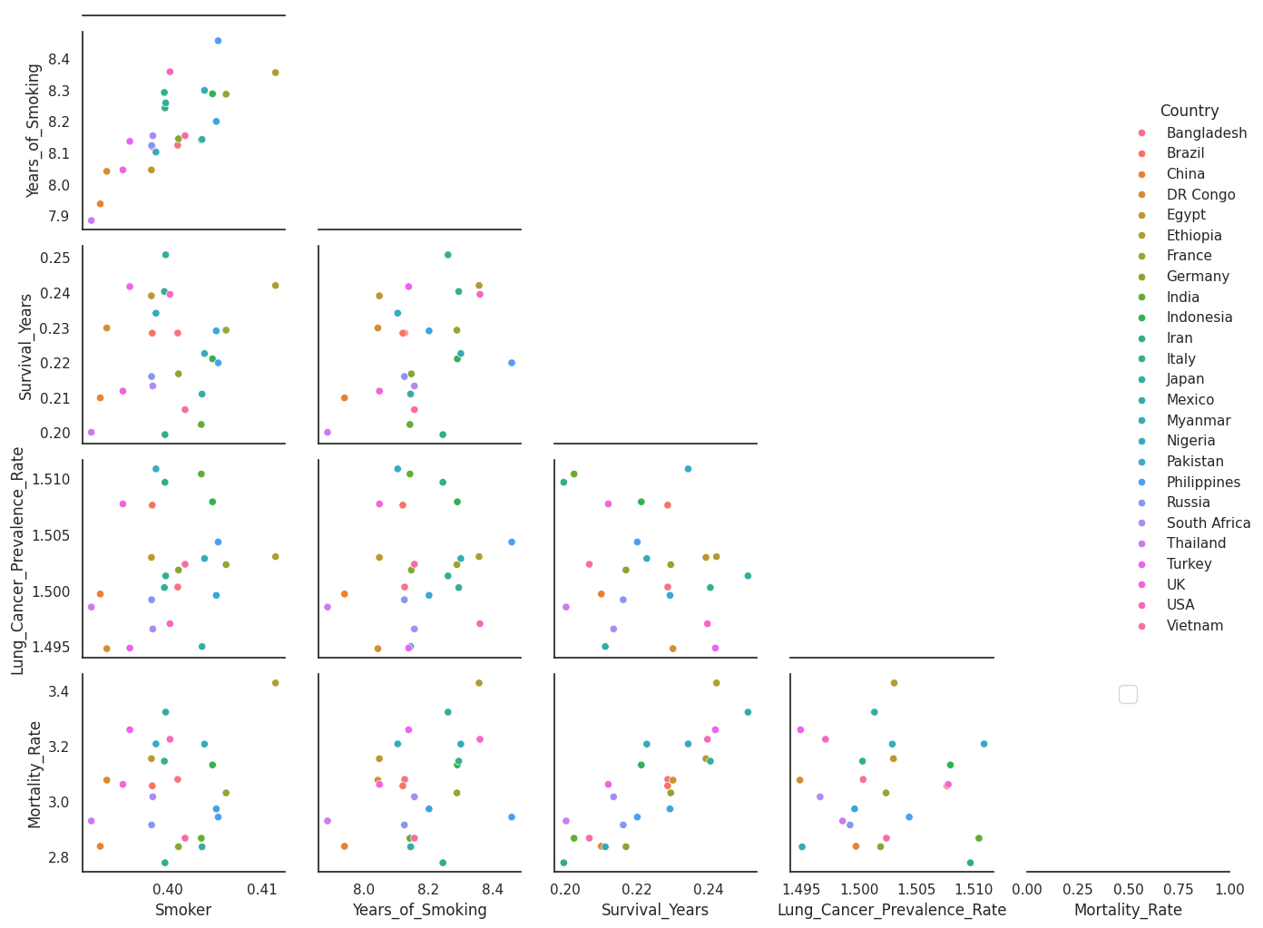
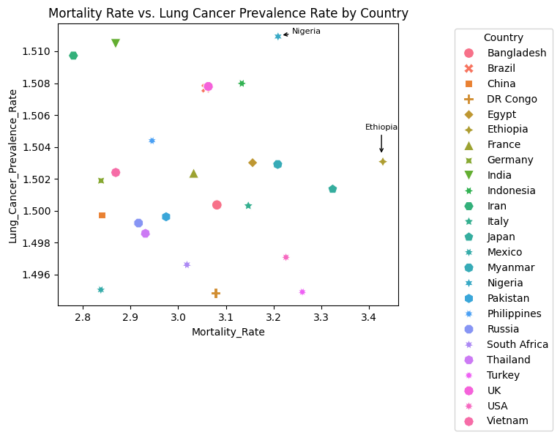
Regional Variations Lung Cancer Prevalence RATE & RISK FACTORS
12

Slide 13
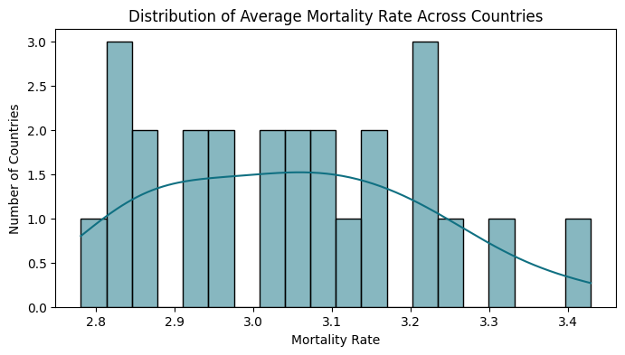
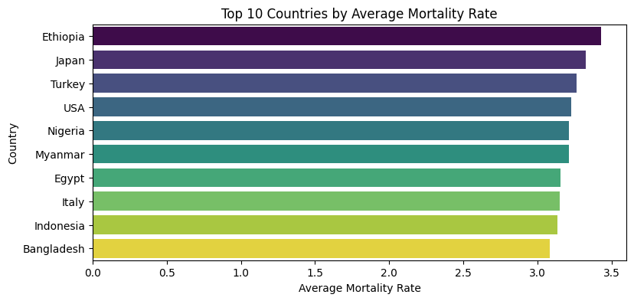
Regional Variations AVERAGE MORTALITY RATE BY COuNTRIES
13

Slide 14
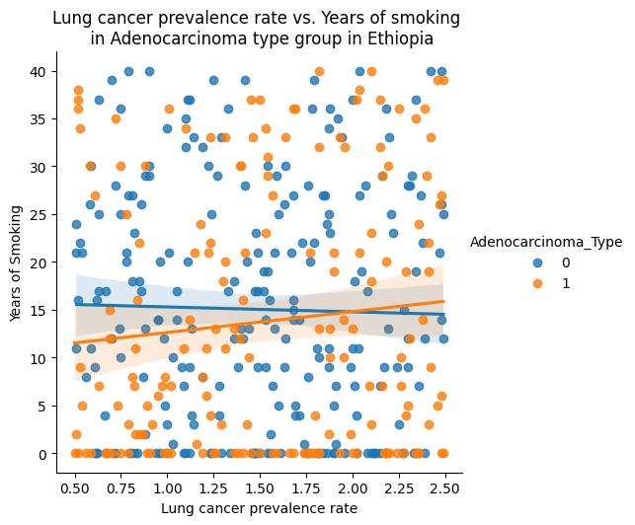
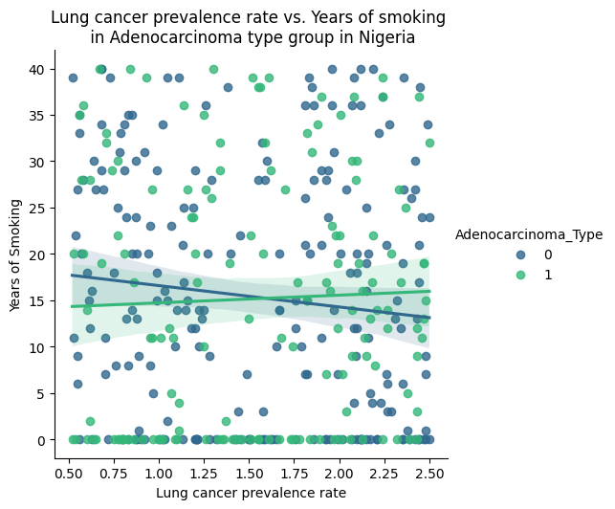
Regional Variations Lung canCErs in Ethiopia vs NIGERIA
14

Slide 15
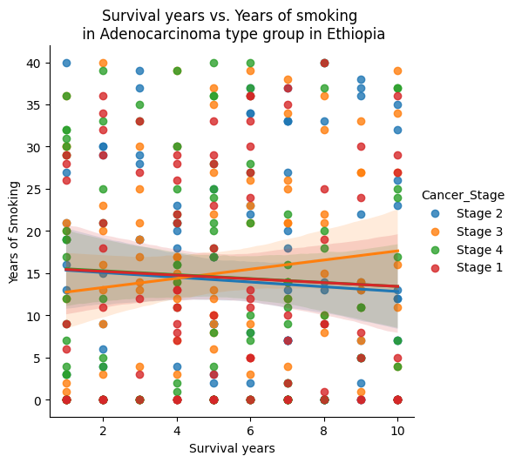
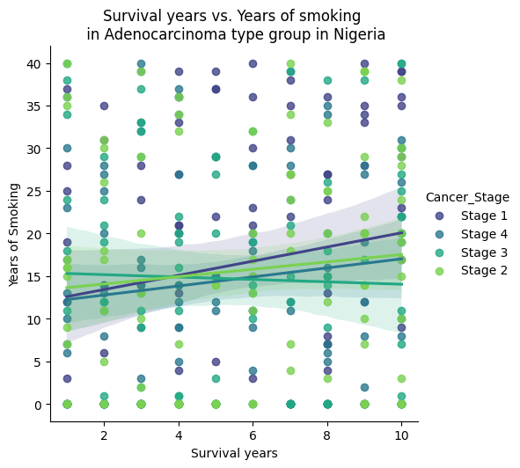
Regional Variations Lung canCErs in Ethiopia vs NIGERIA
15

Slide 16
ConclusionS
Smoking behavior
Demographics
Regional variations
There is positive correlation between smokers with the number of lung cancer diagnosis cases, especially of male heavy and long-term smokers
There are less adenocarcinoma cases of people who are smokers
There is no correlation between family history or passive smoking with the number of lung cancer diagnosis cases
There are more male than female of positive lung cancer diagnosis cases, especially cases with smoking habits
Developed countries show a higher rate of annual lung cancer deaths relative to their population size
Developing countries report a higher number of cases alongside increasing lung cancer prevalence.
Among all countries, Ethiopia and Nigeria stand out with the highest lung cancer mortality and prevalence rates, respectively. However, the relationship between lung prevalence rate/ survival years and years of smoking varies by adenocarcinoma types or cancer stages is different by each country
16

Slide 17

Thank you
Duyen Huynh
duyenhuynh88@gmail.com
https://www.linkedin.com/in/duyen-huynh-lam-chau/

